Slide 1
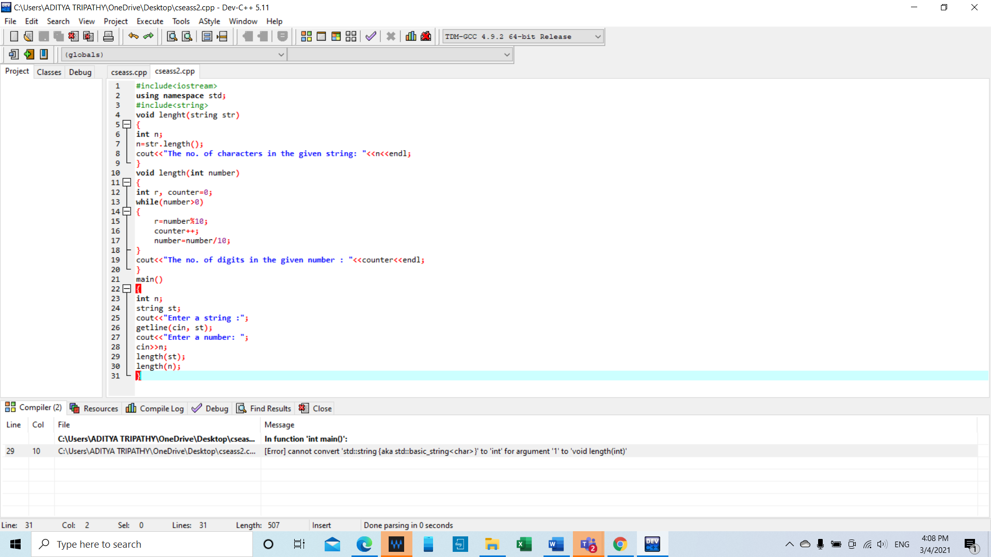

Slide 2
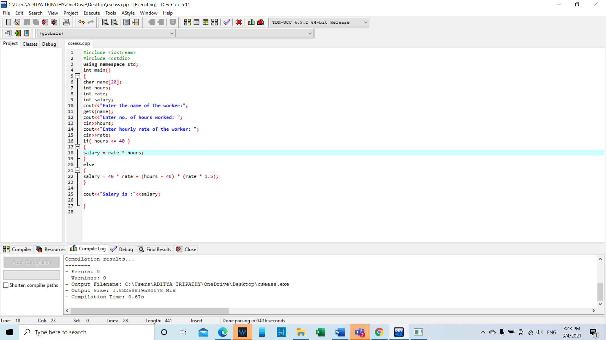

Slide 3
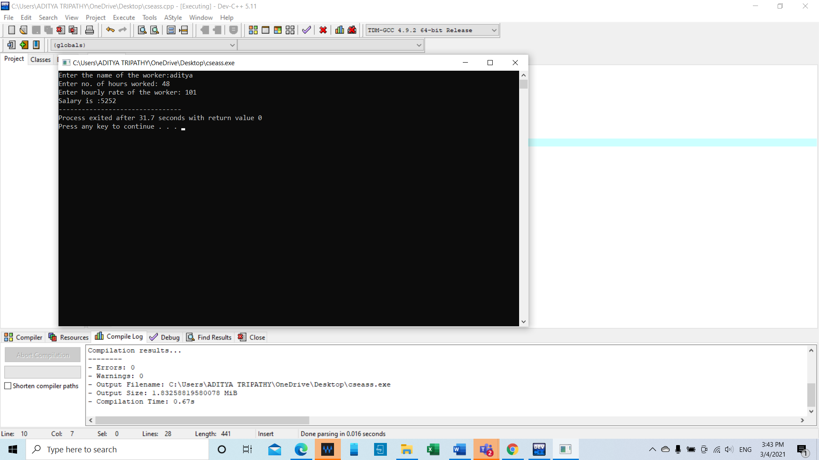

Slide 4
Sorry ma’am I late because my laptop fell and broke..

